Slide 1

CHATTER – A TWITTER CLONE APP
AN ANDROID APPLICATION
Vijaykumar R Pai – PES1201702013
Ayush Pratyay – PES1201702164
Subham Singh – PES1201801830

Slide 2

INTRODUCTION
Chatter is a micro blogging and social networking service on which users post and interact with messages known as "tweets“.
In our project, we tried to make clone of the twitter application which comprises of :
User authentication
Tweets
Tweet likes
Retweets
Follow hashtags
Follow users
News feed

Slide 3

TOOLS AND TECHNOLOGIES
Android Studio 3.5v
Kotlin 1.3v
Firebase 17.0.0

Slide 4
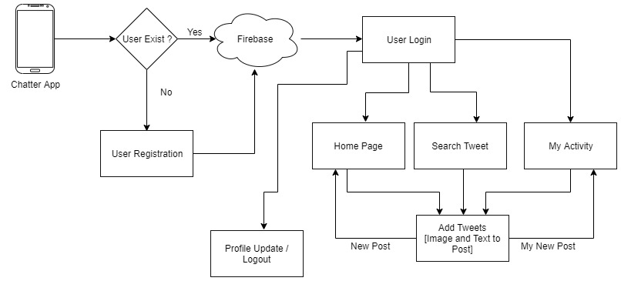
ARCHITECTURE DIAGRAM

Slide 5

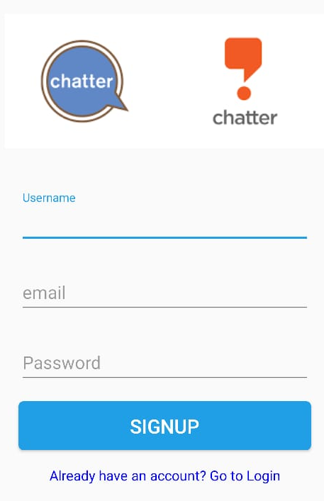
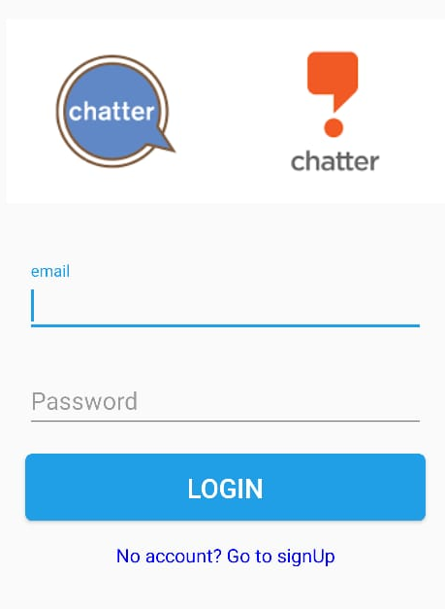
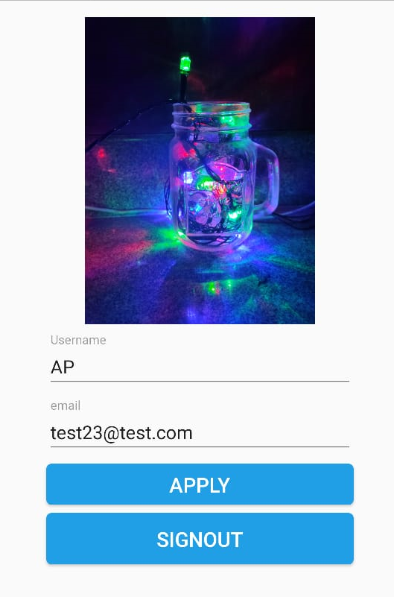
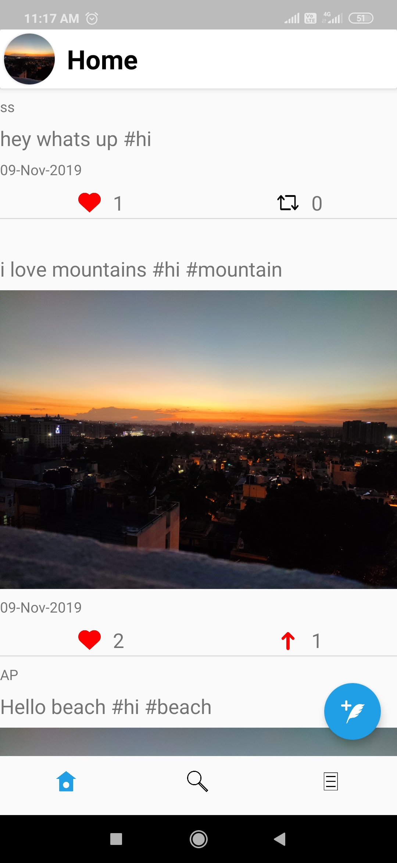
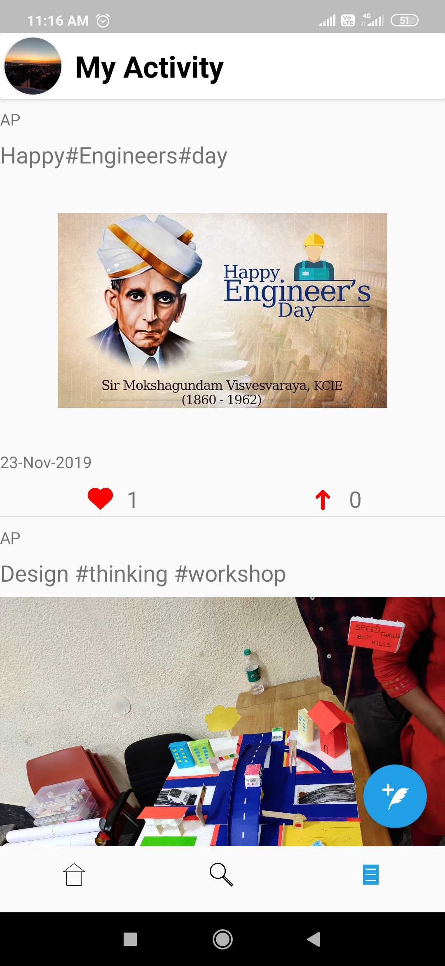
SCREENSHOTS

Slide 6
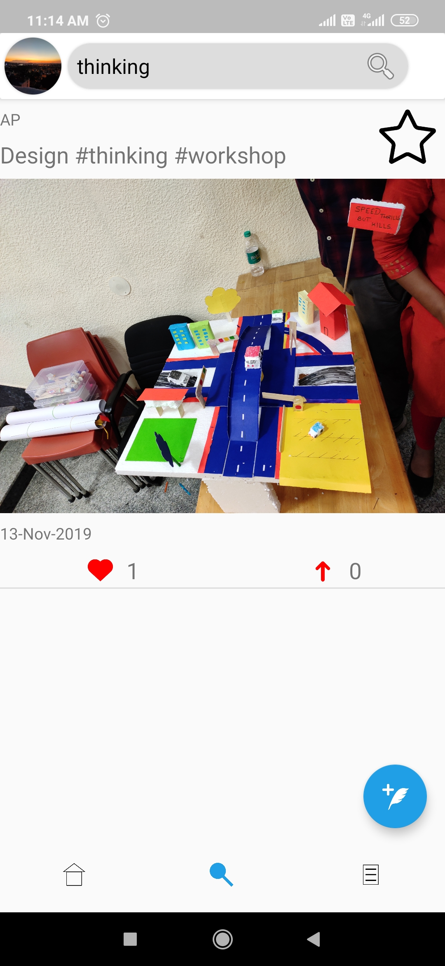
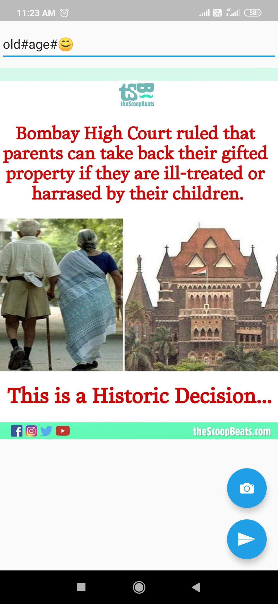

Slide 7
COMMITMENTS COMPLETED
Tweets.
Hashtags.
Tweet likes.
Retweets
Follow hashtags
Follow users
News feed

Slide 8
THANK YOU

